Slide 1



APACHE SPARK DEEP DIVE Dataframe/RDD Size Calculation

Slide 2
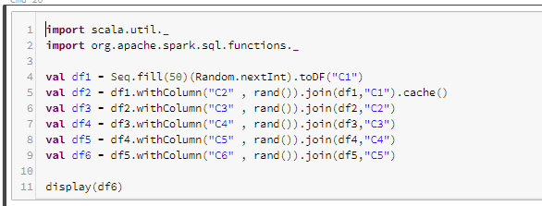
DF/RDD Size calculation
Let’s see it with an example and validate the same on Spark UI

Slide 3
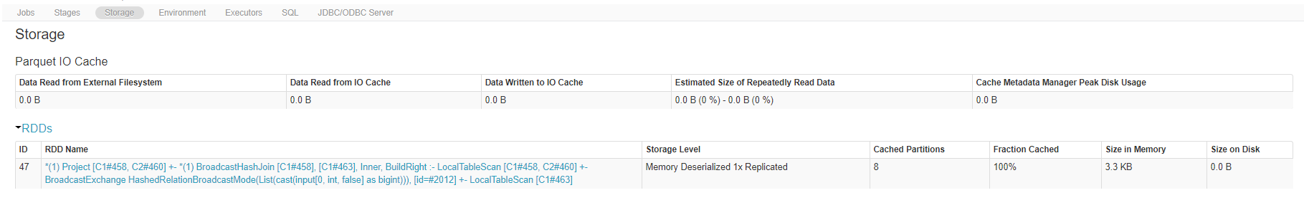

DF/RDD Size calculation

Slide 4
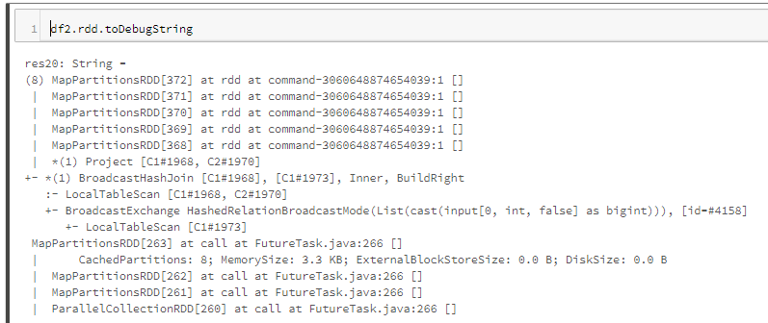
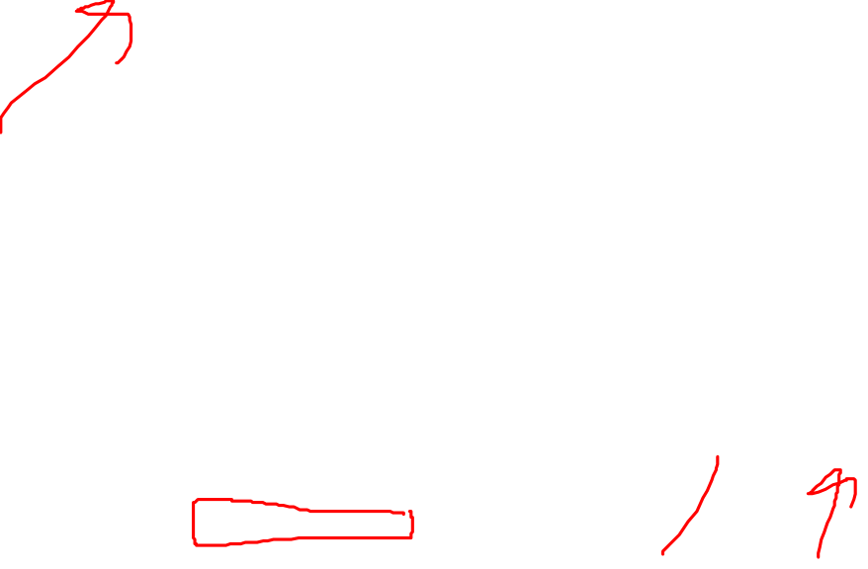
DF/RDD Size calculation

Slide 5
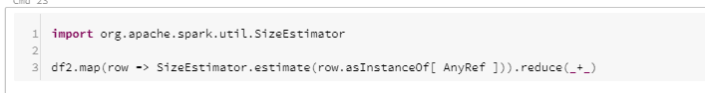
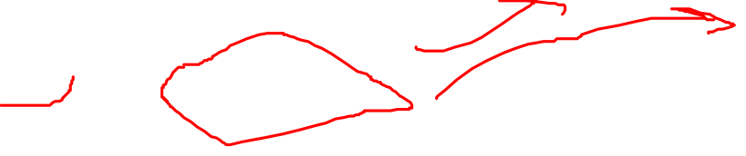
DF/RDD Size calculation

Slide 6
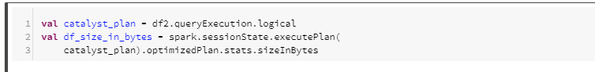

DF/RDD Size calculation

Slide 7
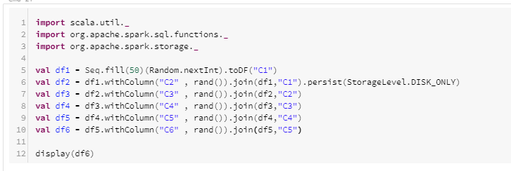
DF/RDD Size calculation

Slide 8
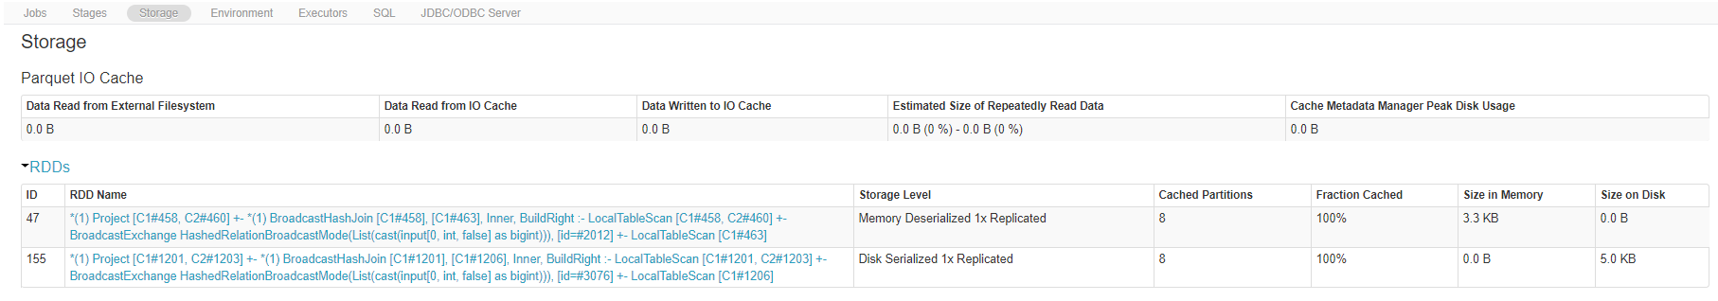

DF/RDD Size calculation

Slide 9
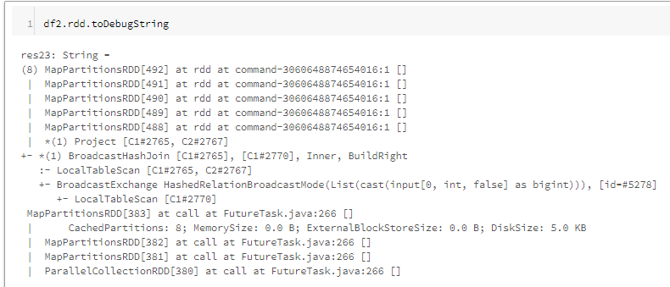

DF/RDD Size calculation

Slide 10
DF/RDD Size calculation
Thanks and do subscribe to my channel

